Slide 1




APSSDC
Andhra Pradesh State Skill Development Corporation
(Department of Skills Development and Training, Govt of Andhra Pradesh)
Web Technologies

Slide 2
Contents
Introduction
Web Development
Web Technologies
HTML

Slide 3
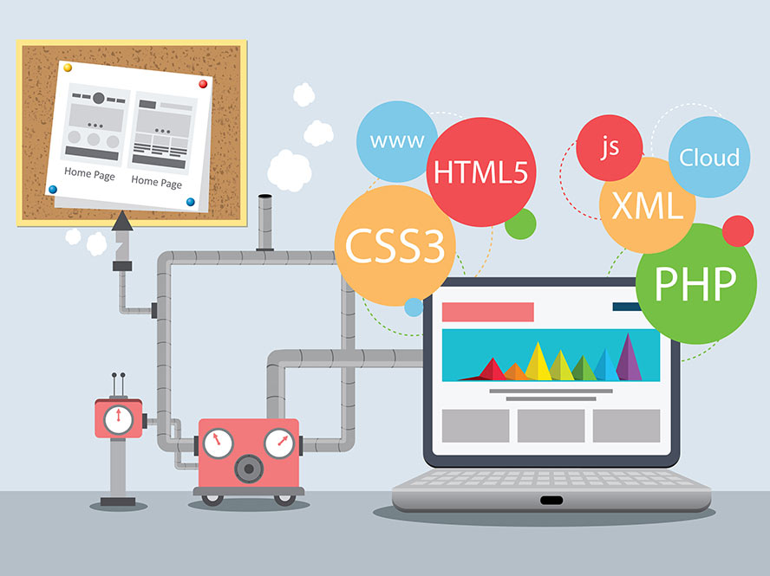
Introduction
Web Technologies : Methods by which computers
are allowed to communicate with each other by
means of sharing resources and connecting people across the world
Technologies used to build Websites and Web Applications

Slide 4
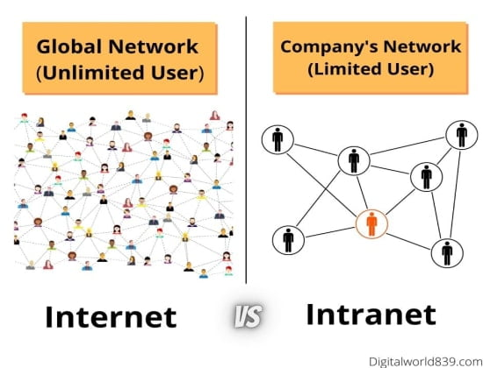
Web Development
Web development involves Developing Websites for the Internet or Intranet
Internet : Global Computer Network to share information
Intranet : Computer network within an organization

Slide 5
Website vs Web Application
Website
A website is a group of globally accessible, interlinked web pages
A website mostly consists of static content. It is publicly accessible to all the visitors
Developing your website helps you in branding your business.
Wikipedia, blogging sites, etc.
Web Application
A web application is a software or program which is accessible using any web browser
A web application is designed for interaction with the end user
App store approval not required in web applications
Ex: Gmail, Facebook, YouTube, etc.

Slide 6

Name some websites and web applications that you know..

Slide 7
Types of Websites
Business Websites
Portfolio Websites
Blogging Websites
E-Commerce Websites
Magazine and News Websites

Slide 8
Web Developer
A person who develops and maintains websites
Types:
Front-End Developer
Back-End Developer

Slide 9
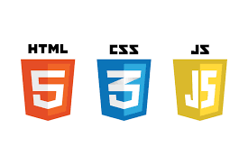
Front-End
The part of a website that the user interacts with directly is termed the front end. It is also referred to as the ‘client side’ of the application. It includes everything that users experience directly
Technologies
HTML
CSS
JavaScript

Slide 10
HTML : To define the structure
CSS : Styling
JavaScript : Interaction

Slide 11
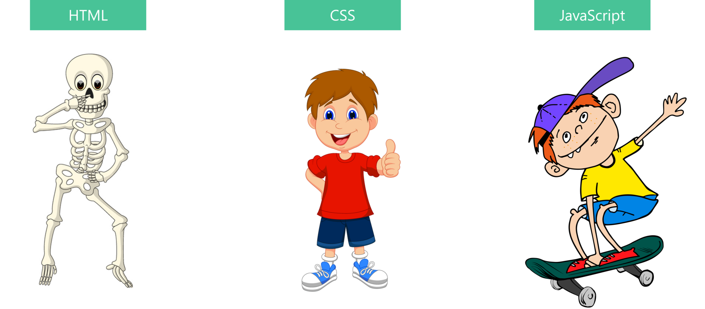

Slide 12
HTML
Stands for Hyper Text Markup Language
It is a standard markup language
Markup Language : Language of Web. Set of rules defined to format a document
HTML Tags :
<p>, <h1>, <img>
</p>, </h1>
Basic Tags
<!DOCTYPE html>: It is an "information" to the browser about what document type to expect.
<HEAD> : Container for Metadata (data about data).
title, character set, styles, scripts, and other meta information.
<BODY> : Contains the user visible content

Slide 13


